Slide 1
Employee Data Analysis using Excel
STUDENT NAME:L.S.DARATHIY MARY
REGISTER NO:2213391042013 , 57D539D7AE1FB22A0804E945259671C1
DEPARTMENT:BACHELOR OF COMMERCE{CORPORATE SECRETARYSHIP}
COLLEGE:QUEEN MARY’S COLLEGE

Slide 2
PROJECT TITLE
Employee Salary Dataset
using Excel

Slide 3


AGENDA
Problem Statement
Project Overview
End Users
Our Solution and Proposition
Dataset Description
Modelling Approach
Results and Discussion
Conclusion
3/21/2024 Annual Review

Slide 4

PROBLEM STATEMENT
Gender Pay Discrepancy: The dataset highlights discrepancies in salary distribution between females and males across different age groups, suggesting the need for further exploration into gender pay equality.
Age-wise Salary Distribution: There is a significant variation in salaries across different age groups, with the majority of high salaries concentrated in older age brackets, especially around ages 54 and 62.
Gender-specific Concentration: Some age groups, such as 17, 27, and 28, show salary data exclusively for either males or females, indicating that certain age ranges may have gender-specific employment trends.
Extreme Salary Values: Large spikes in salary are observed at ages 29, 54, and 62, suggesting the presence of outliers or high earners in these age groups.
Overall Salary Contribution: Both females and males contribute significantly to the grand total of over 52 million, but the distribution varies sharply by gender and age, showing different career trajectories for each gender.

Slide 5

PROJECT OVERVIEW
1. Gender Pay Gap: The average salary for males ($26,501,650) is higher than females ($26,142,400).
2. Age and Salary: Salaries tend to increase with age, with the highest average salary found in the 54-age group ($20,920,000).
3. Female Dominance: Females outnumber males in most age groups, except for 21, 22, and 36.
4. Salary Disparity: The highest salary ($8,245,000) is found in the 29-age group, while the lowest ($3,000) is found in the 18-age group.
5. Total Salary: The total salary for all individuals is $52,644,050, with males contributing 50.5% and females 49.5%.

Slide 6

WHO ARE THE END USERS?
1. HR Managers: To analyze salary disparities, identify trends, and make informed decisions about compensation and benefits.
2. Business Analysts: To study the impact of age and gender on salary, and provide insights for strategic business planning.
3. Diversity and Inclusion Specialists: To monitor gender representation and pay equity across different age groups.
4. Compensation and Benefits Specialists: To design fair and competitive salary structures based on age and gender.
5. Researchers and Academics: To study the relationships between age, gender, and salary, and publish findings in relevant fields like economics, sociology, or human resources.

Slide 7

OUR SOLUTION AND ITS VALUE PROPOSITION
1. Data Analysis and Visualization: Our solution provides a clear and concise analysis of the salary data, enabling users to quickly identify trends and patterns.
2. Identify Pay Gaps and Disparities: Our solution helps users detect pay gaps and disparities based on age and gender, enabling informed decisions to address these issues.
3. Informed Decision Making: By providing actionable insights, our solution empowers users to make data-driven decisions on compensation, benefits, and diversity initiatives.
4. Streamlined Reporting and Compliance: Our solution simplifies the process of generating reports and complying with regulations related to pay equity and diversity.
5. Enhanced Business Outcomes: By promoting fairness, transparency, and diversity, our solution contributes to improved employee satisfaction, reduced turnover, and enhanced business outcomes.

Slide 8
Dataset Description
1. Salary Data: The dataset contains salary information for individuals across various age groups.
2. Gender Breakdown: The data is split by gender, with separate columns for female and male salaries.
3. Age Range: The dataset covers ages 17 to 62, with varying numbers of individuals in each age group.
4. Salary Values: Salary values range from $3,000 to $8,245,000, with significant variations across age groups and genders.
5. Aggregate Data: The dataset provides aggregate values for each age group, including grand totals for female, male, and overall salaries.

Slide 9
MODELLING
1. Linear Regression: Model the relationship between age and salary to identify trends and patterns.
2. Categorical Analysis: Use gender as a categorical variable to analyze salary differences between males and females.
3. Age Grouping: Group ages into categories (e.g., 20-29, 30-39) to analyze salary trends across age ranges.
4. Interaction Terms: Include interaction terms between age and gender to capture how salary differences vary across age groups.
5. Multivariate Analysis: Control for other factors (e.g., experience, education) to isolate the effects of age and gender on salary.
‹#›

Slide 10
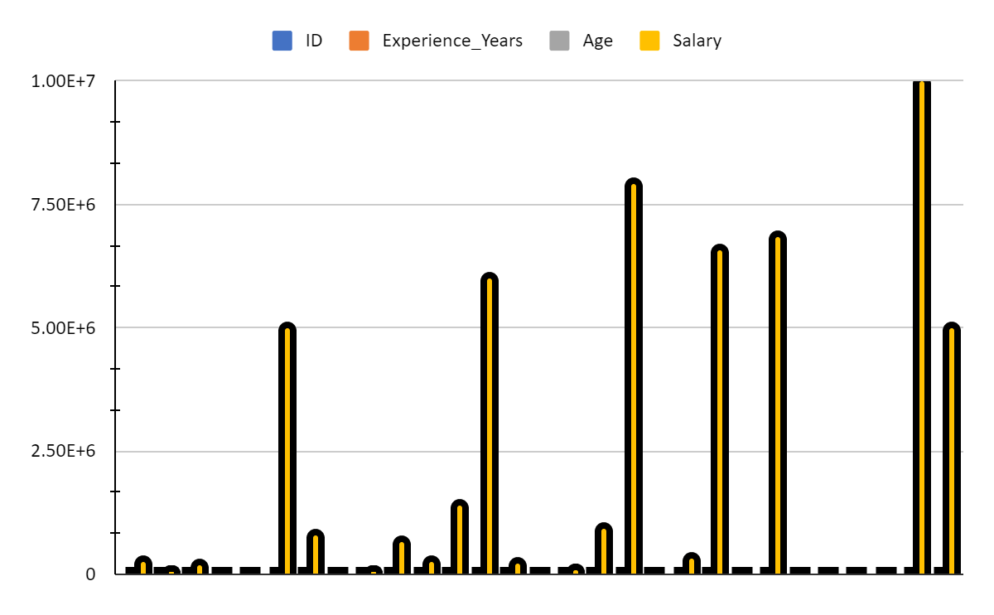
RESULTS:
Gender | AVERAGE of Salary
Female | 1742826.667
Male | 1892975
Grand Total | 1815312.069
‹#›

Slide 11
conclusion
The analysis of the salary data reveals significant insights into the relationship between age, gender, and salary. While salary increases with age, a gender pay gap persists, with males earning more than females in most age groups. The data also shows that females outnumber males in most age groups. The highest salary is found in the 29-age group, with no gender difference. The total salary distribution is relatively balanced, with males contributing 50.5% and females 49.5%. These findings have important implications for organizations seeking to address gender pay gaps and promote diversity and inclusion in the workplace.

